Slide 1
Design and Analysis of Shock Absorber of a Two Wheeler
MEE305
DESIGN PROJECT
Review 1
Submitted by
Sargam Arora-1BME0102
Nikhil Pandita- 14BME0133

Slide 2
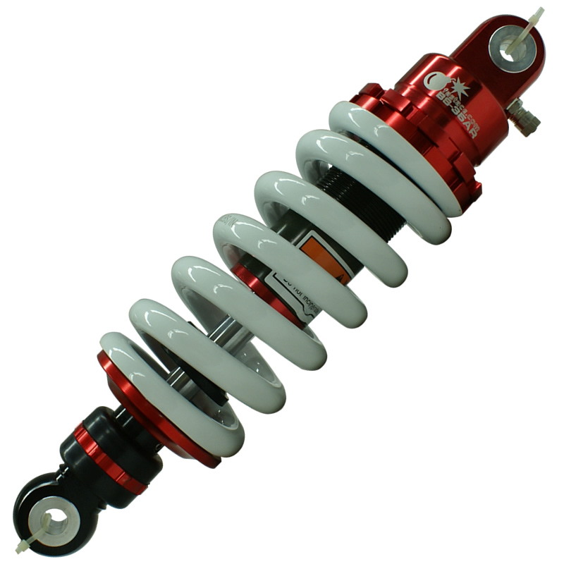
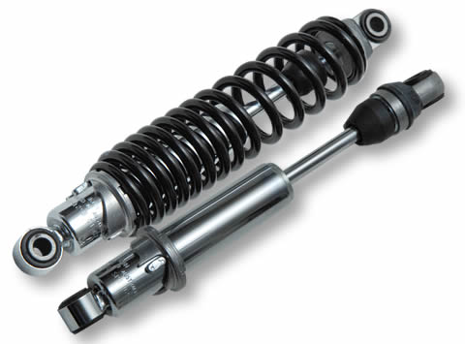

Slide 3
WHAT IS A SHOCK ABSORBER? AND WHAT IS ITS PURPOSE?
In a vehicle, shock absorbers reduce the effect of traveling over
rough ground, leading to improved ride quality and vehicle
handling. While shock absorbers serve the purpose of limiting
excessive suspension movement, their intended sole purpose
is to damp spring oscillations.

Slide 4
Ideal springs alone, however, are not shock absorbers, as springs only store
and do not dissipate or absorb energy. Vehicles typically employ both
hydraulic shock absorbers and springs or torsion bars. In this combination,
"shock absorber" refers specifically to the hydraulic piston that absorbs and
dissipates vibration.

Slide 5
PROJECT AIM
The purpose of this Project is to design the Shock Absorber in SolidWorks, and do its Stress Analysis in Ansys. The Stress Analysis if first done for the conventional materials of the spring of the Shock Absorber, which will later be replaced by other materials, so as to find out the most optimum choice of material for the Shock Absorber

Slide 6
Modeling Components of a shock absorber
A shock Absorber has 4 components, namely
Base
Top Rod
Spring
Nut

Slide 7
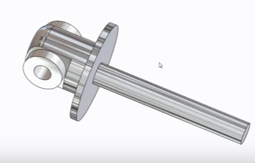
1.) BASE
It is made up of Polished Aluminium

Slide 8
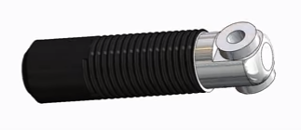
2.) Top ROD
The Top Rod is made up of High Gloss Aluminium with a surface coating of Plastic.
The length of the threads is upto 50mm with the pitch being 3 mm.

Slide 9
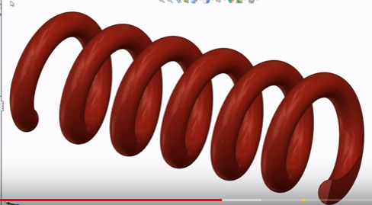
3.) SPRING
The Spring is made up of Polished Steel, with a top coating of Medium Gloss Plastic
Its thickness is 7.25 mm, and it has 6 number of turns

Slide 10
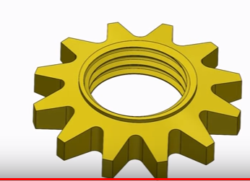
4.) NUT
The Nut has 12 teeth and is tapered at an angle of 15 degrees.
It is made up of Steel, with a top coating of Low Gloss Plastic

Slide 11
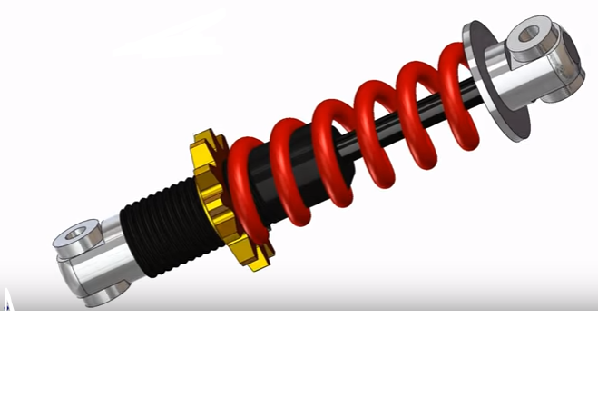
The final assembly

Slide 12
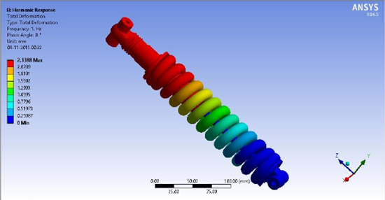
Analysis
The model was designed as shown above in Solidworks and then imported into ANSYS Workbench for evaluation of stress and deflection of its various components. The “Assembly” file from DSS environment had to be first translated into a “PARA” file, which was then imported into the “ANSYS -Mechanical APDL” environment for further stress analysis.
Until now, the analysis has been done on the conventional spring material, ie, stainless steel. The minimum deflection has been found out to be 1.9713 mm.
And the highest deflection has been found out to be 18.4931 mm.

Slide 13
Scope for Review II
We aspire to develop such a solution to the aforementioned problem that could potentially cater to the modern day material engineering needs. The scope of the future study would be to add tests for stress failure analysis while changing the materials employed, from spring steel to viz. Phosphor Bronze,Monel, Carbon fiber, Beryllium Copper and Chromium-Steel.

Slide 14
Other recent developments pertaining to this project can be easily followed at http://14BME0133.github.io/MEE305/ until the next discussion.

Slide 15
THANK YOU

